Slide 1
MY SQL

Slide 2
Introduction to MYSQL
Getting started with MySQL and GUI tool
Fundamentals of RDBMS and database designs
Data Retrieval Technique
Data Modification Technique

Slide 3
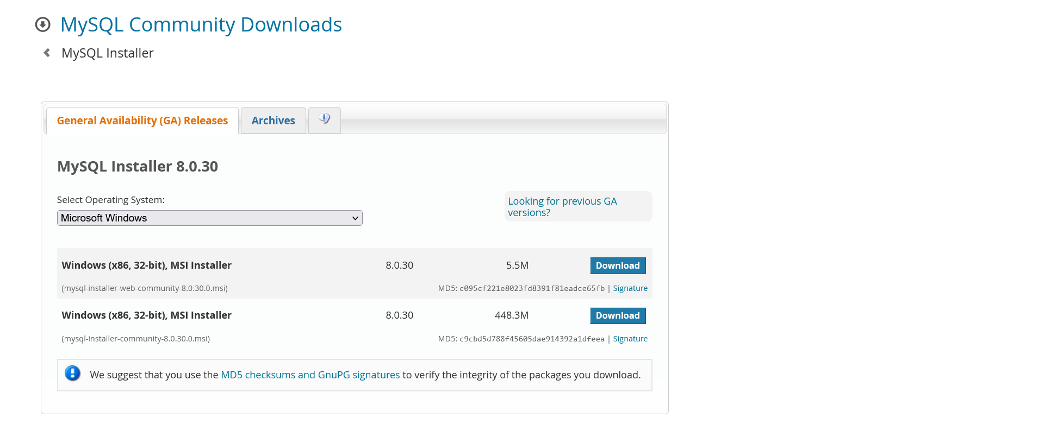
Introduction to MySQL
You can download MySQL from this given link
http://dev.mysql.com/downloads/

Slide 4
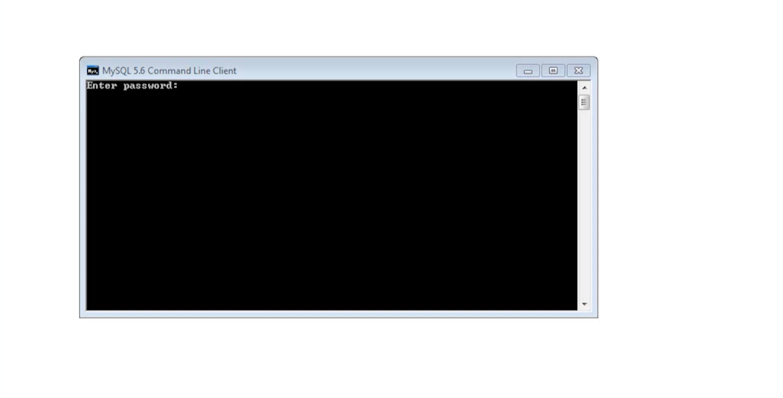
Once installed it just try with password root

Slide 5
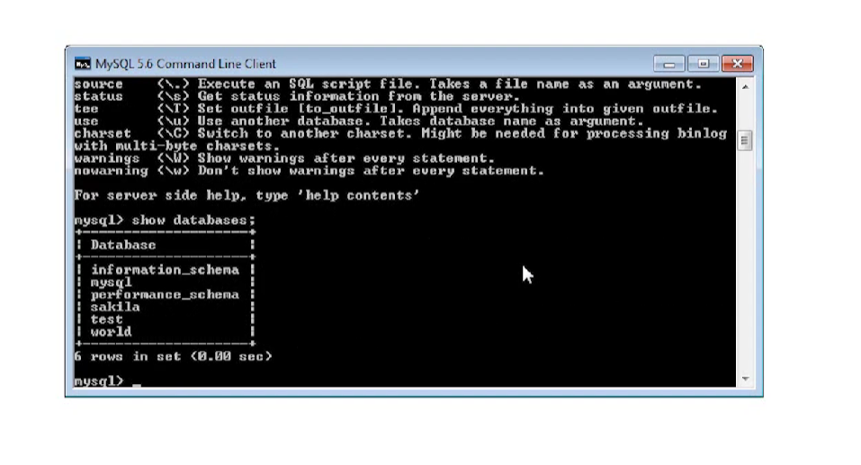
Show databases;

Slide 6
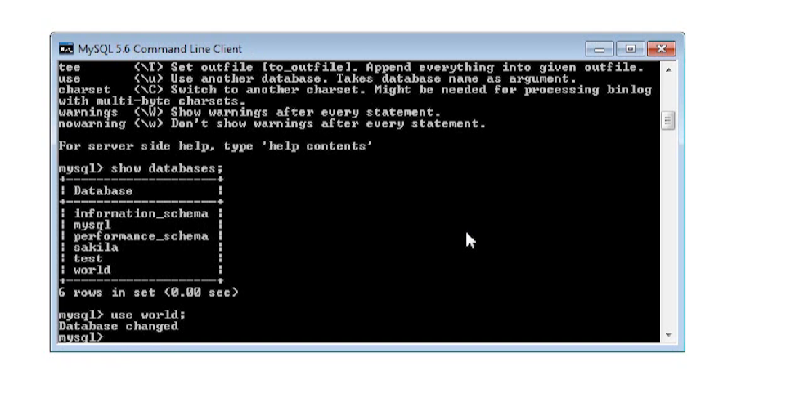
Use database_name;

Slide 7
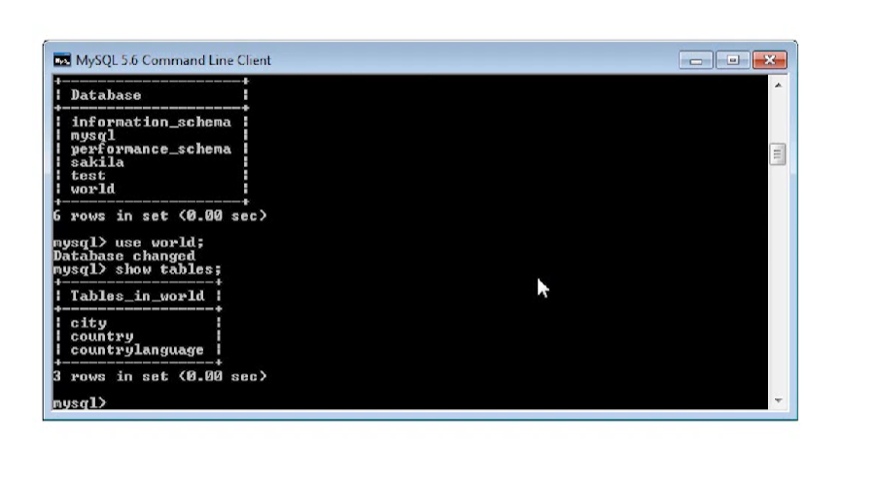
Show tables;

Slide 8
Data Retrieval Techniques
Basic of SELECT statement:
SELECT Column_List
FROM Table_Name
WHERE Filter_Condition
ORDER BY Column_list
LIMIT Row_limit

Slide 9
Beginning SELECT statement
Retrieve Static value
Retrieve all the data from table
Retrieve all the data by single column
Retrieve selected column from table
Retrieve the data with filter condition
Retrieve empty result set

Slide 10
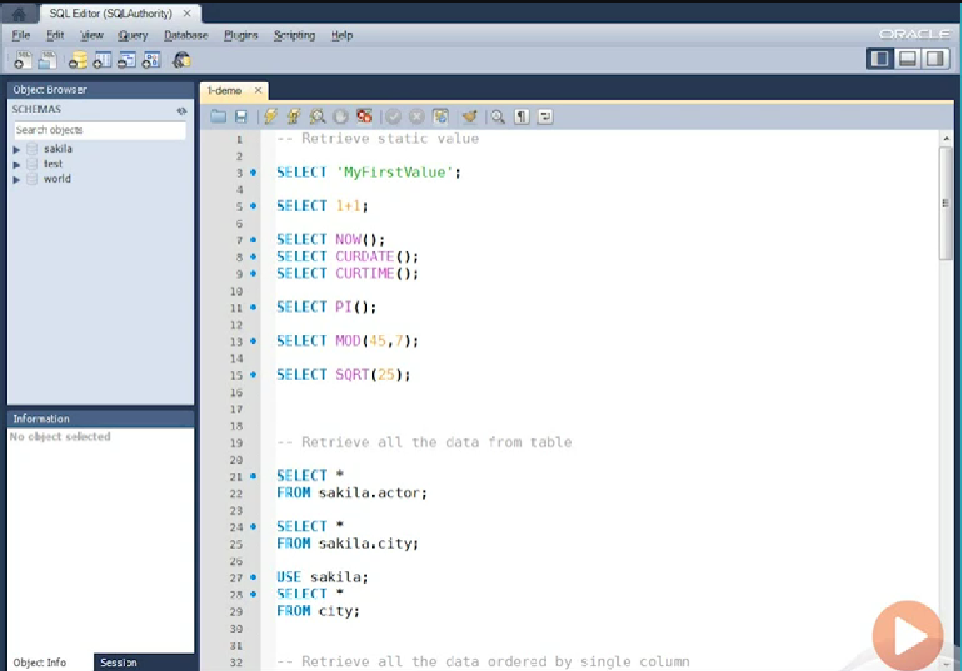
Let’s start with simple example:

Slide 11
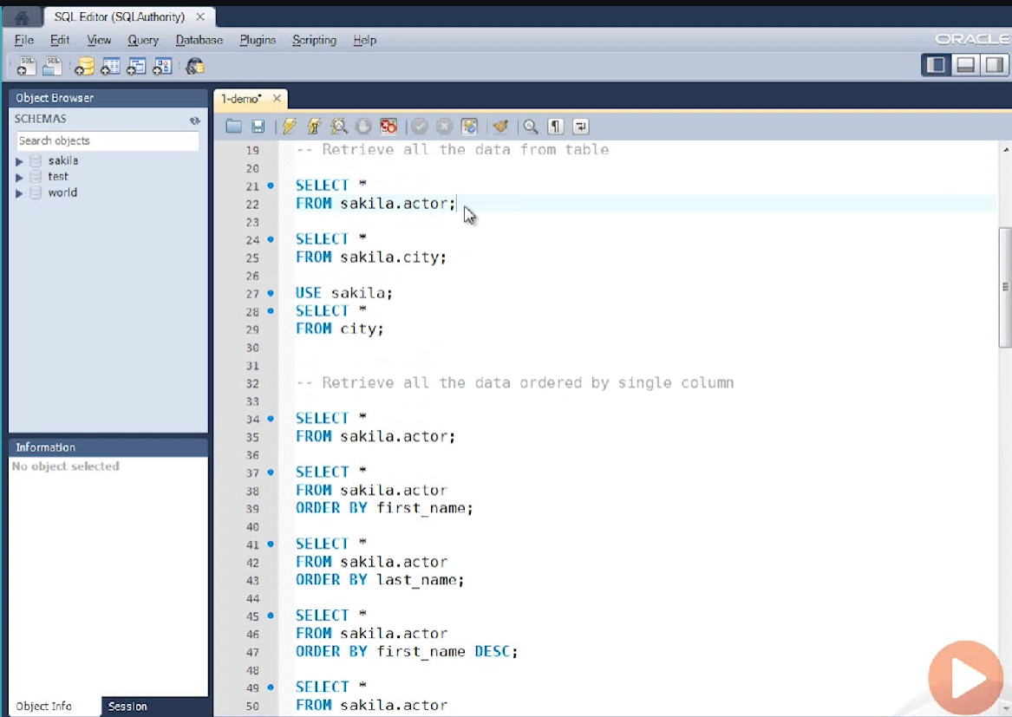
Retrieve data from table

Slide 12
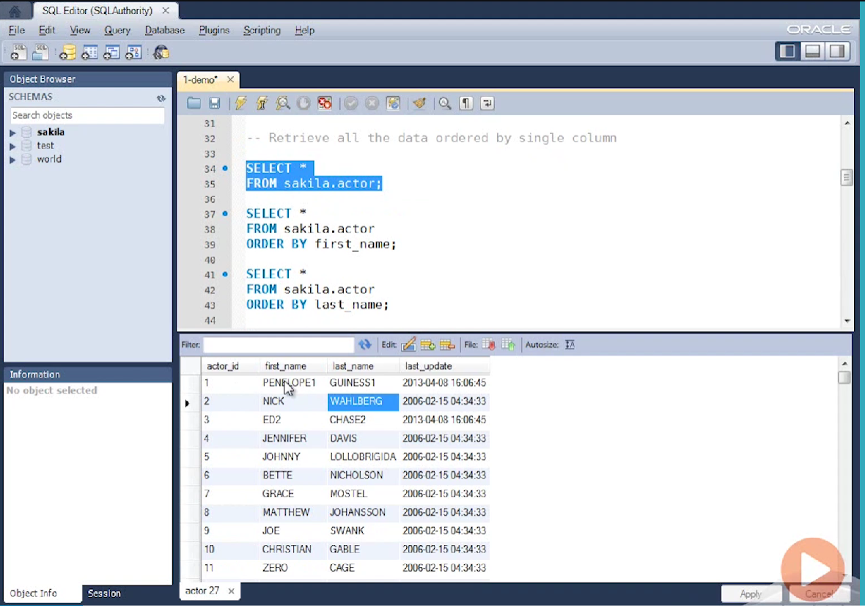

Slide 13
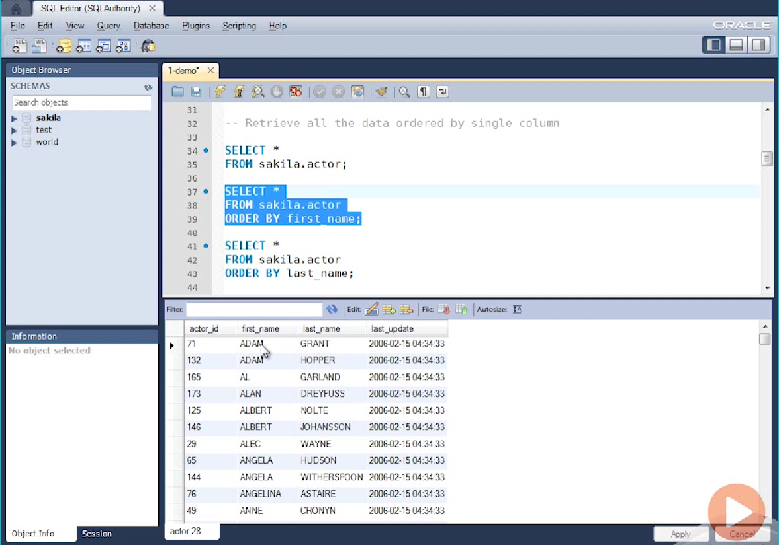
Retrieve all the data ordered by single column

Slide 14
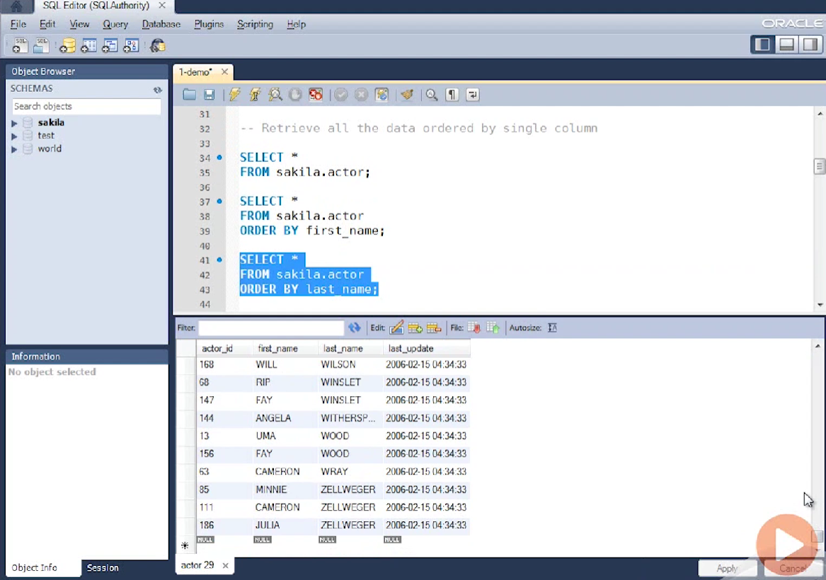
Oreder by last_name

Slide 15
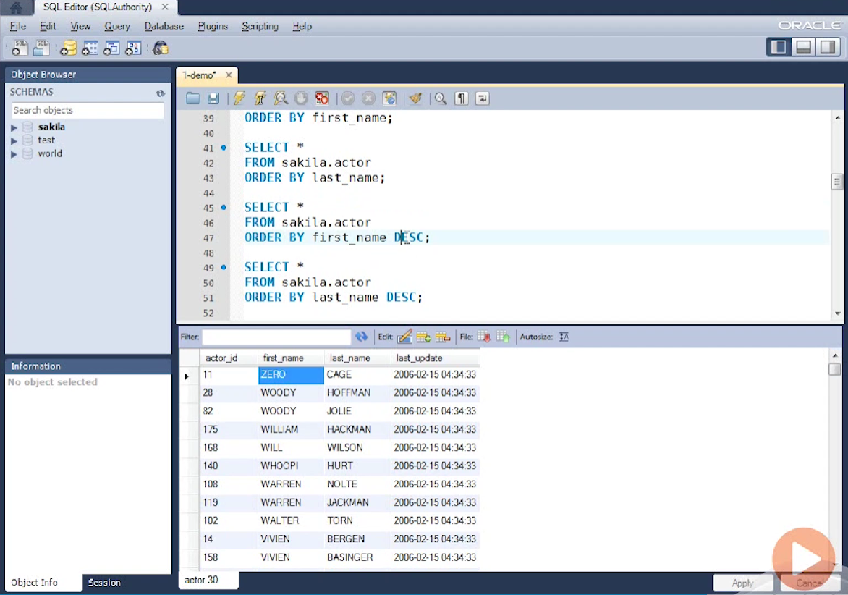
Order by descending

Slide 16
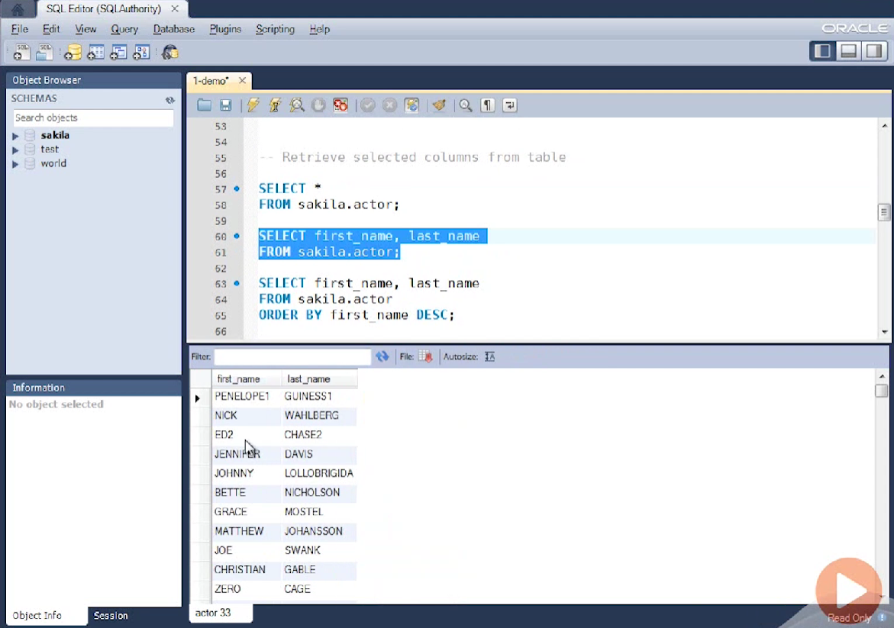
Retrieve selected columns from table

Slide 17
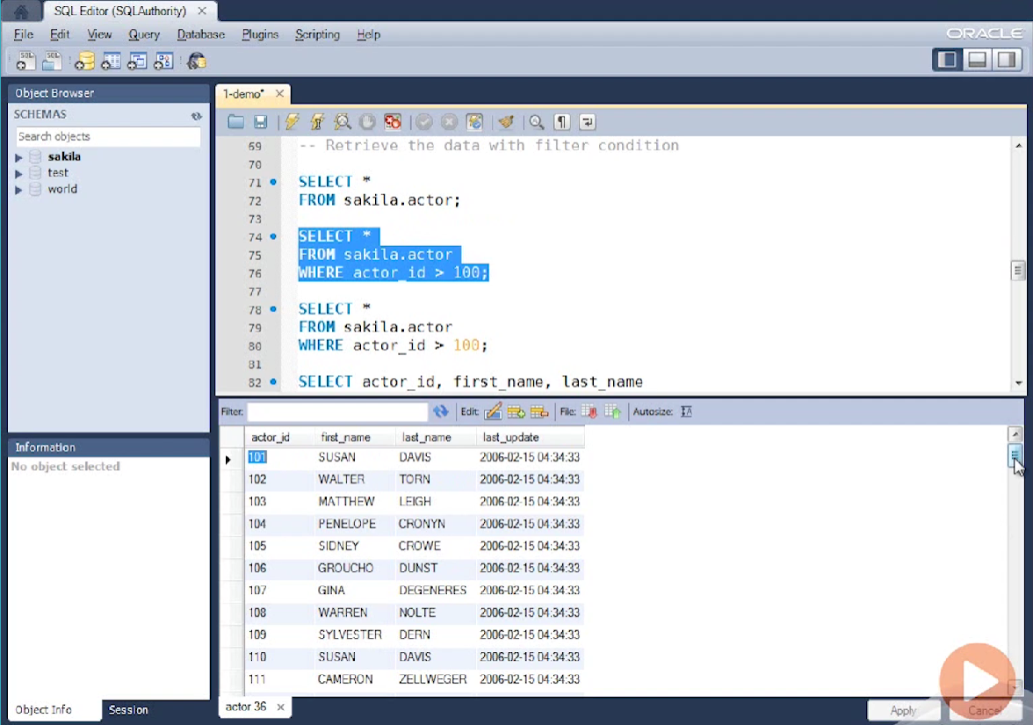
Retrieve from rows

Slide 18
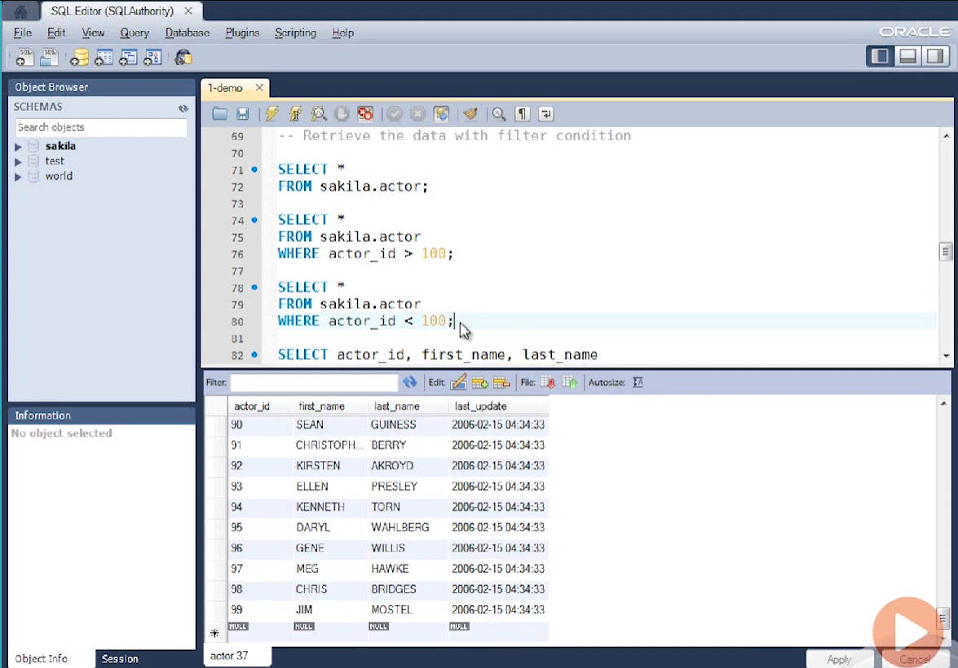

Slide 19
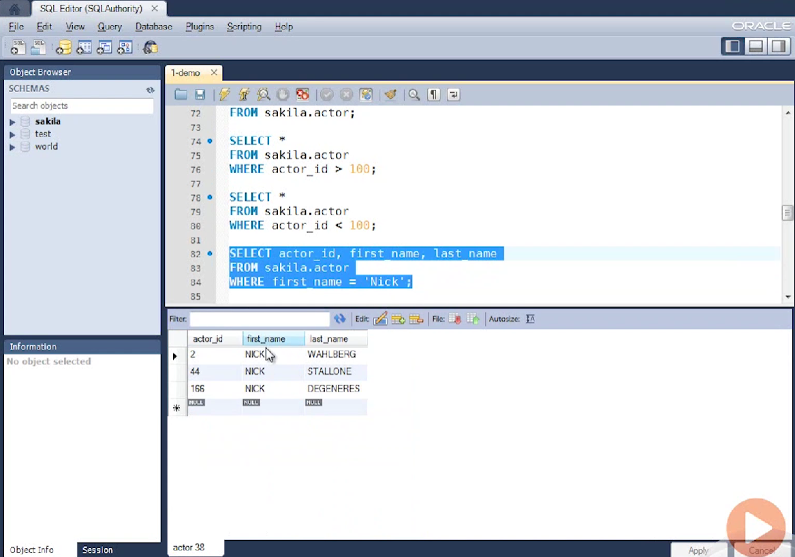

Slide 20
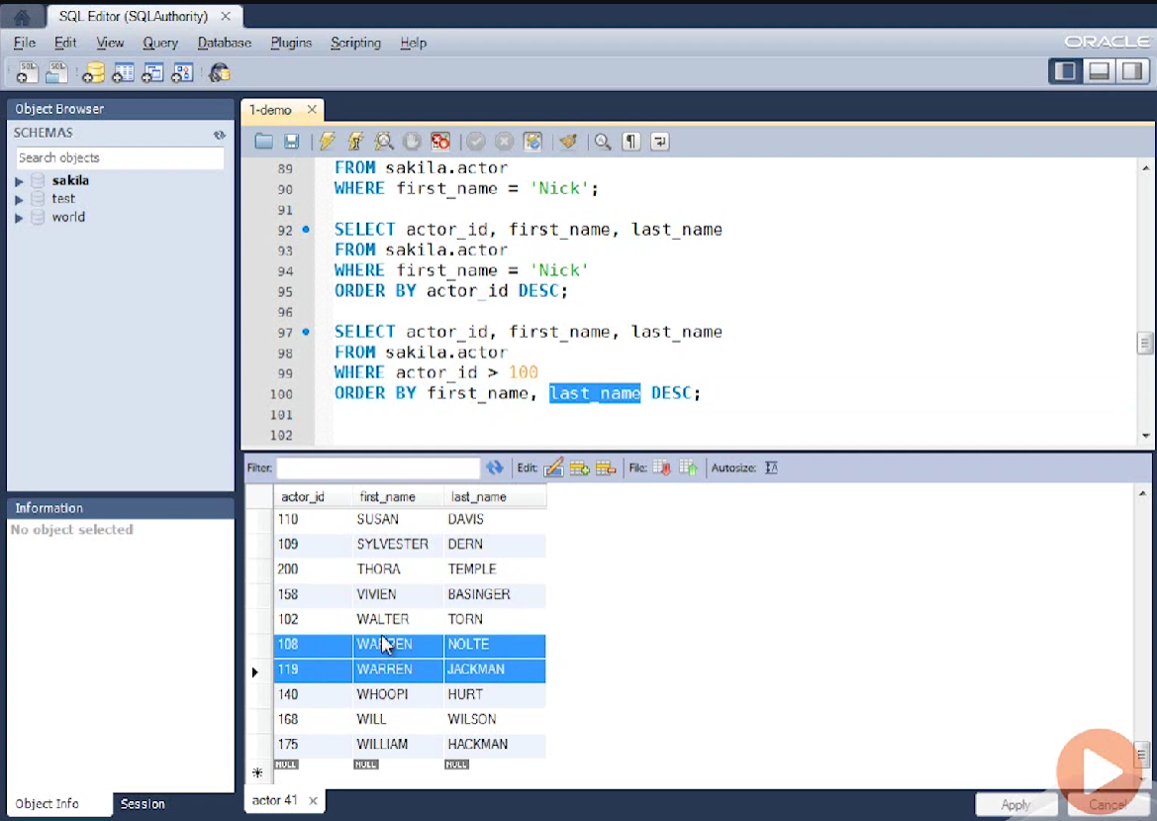

Slide 21
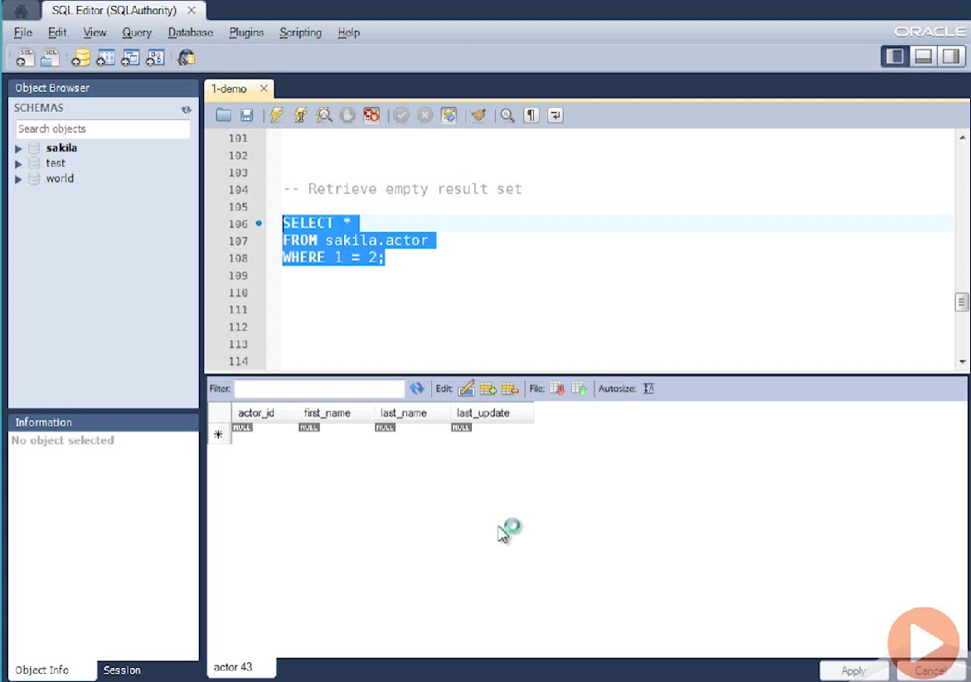
Retrieve empty result set

Slide 22
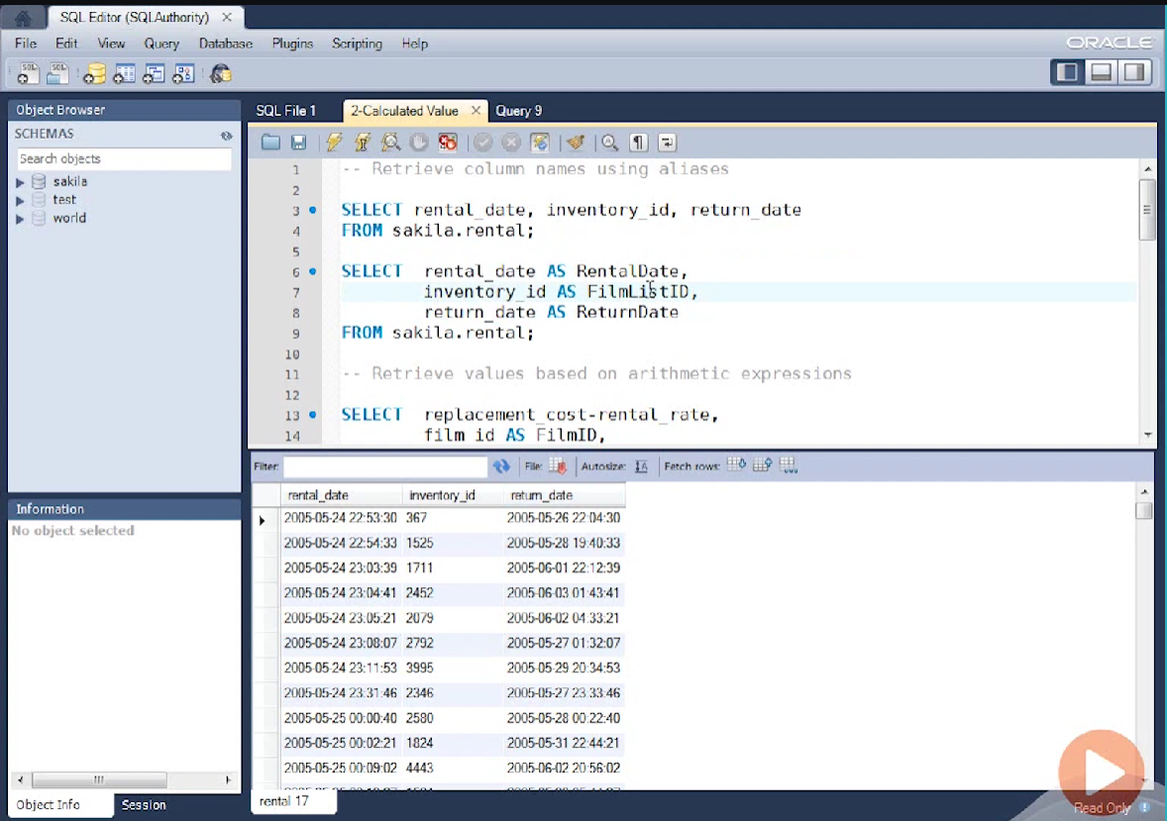
Retrieve column name using aliases

Slide 23
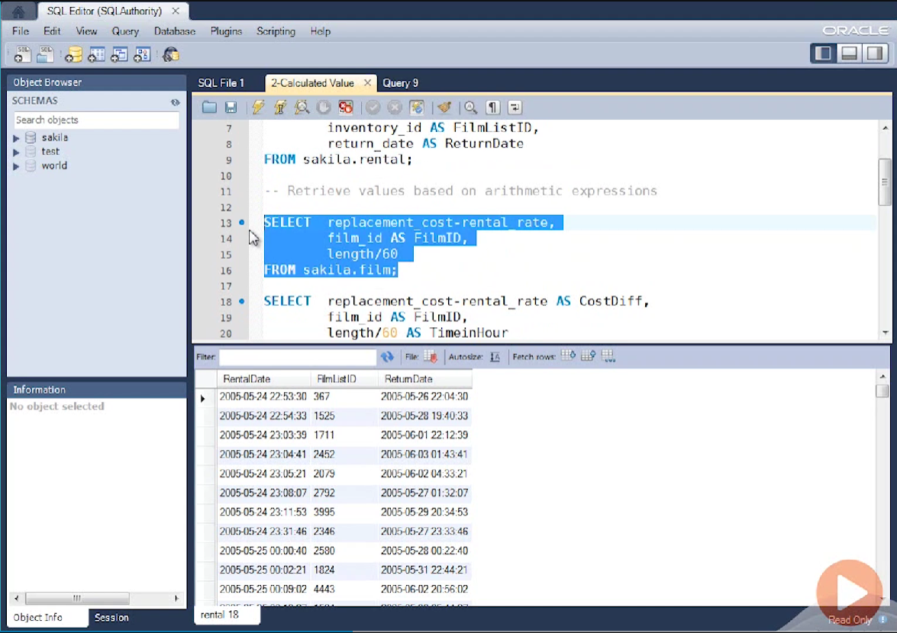
Retrieve values on the base of arithmetic expression

Slide 24
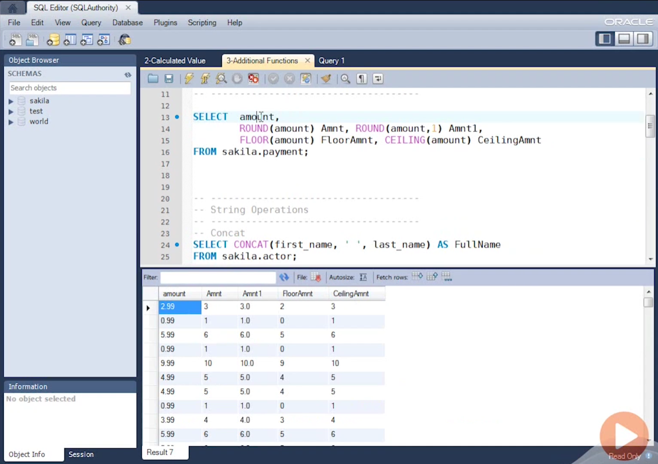
Additional function

Slide 25
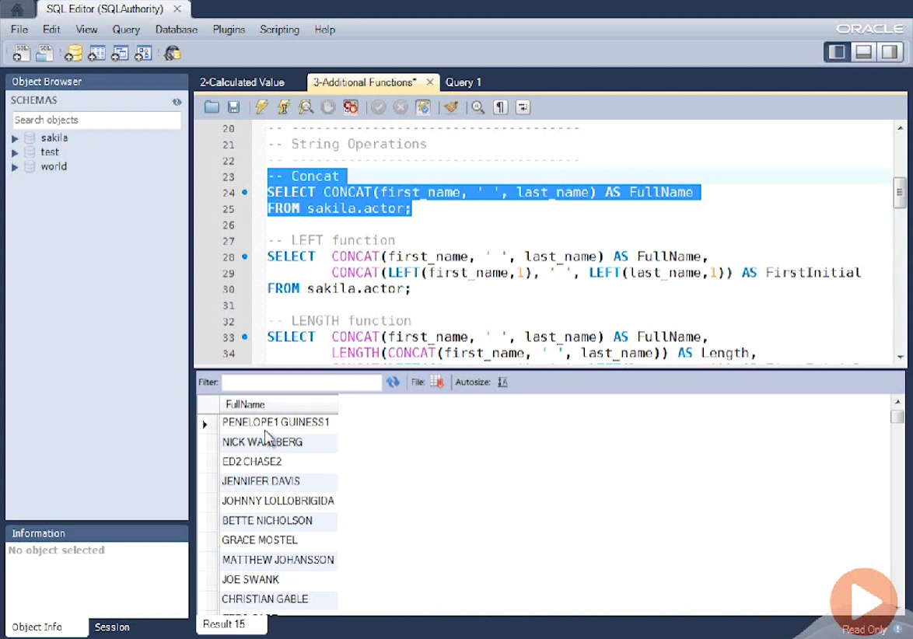
Concat two strings

Slide 26
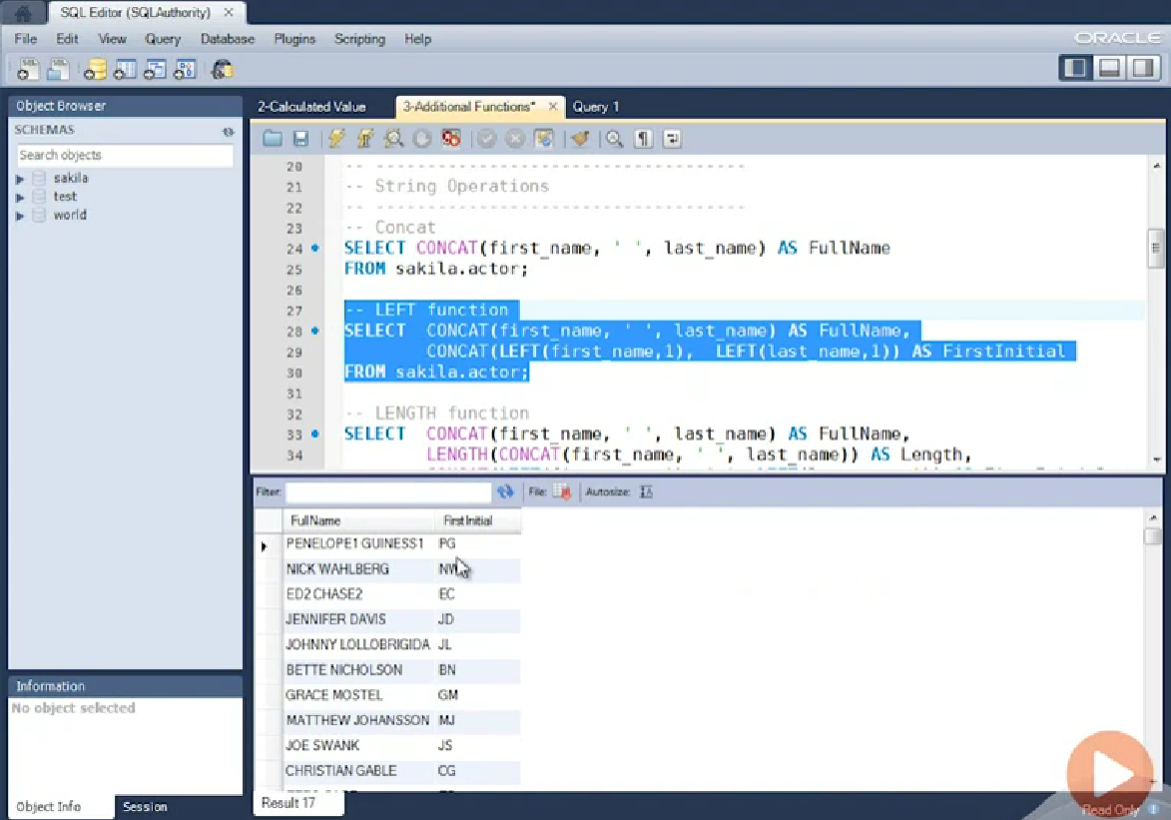
Left function

Slide 27
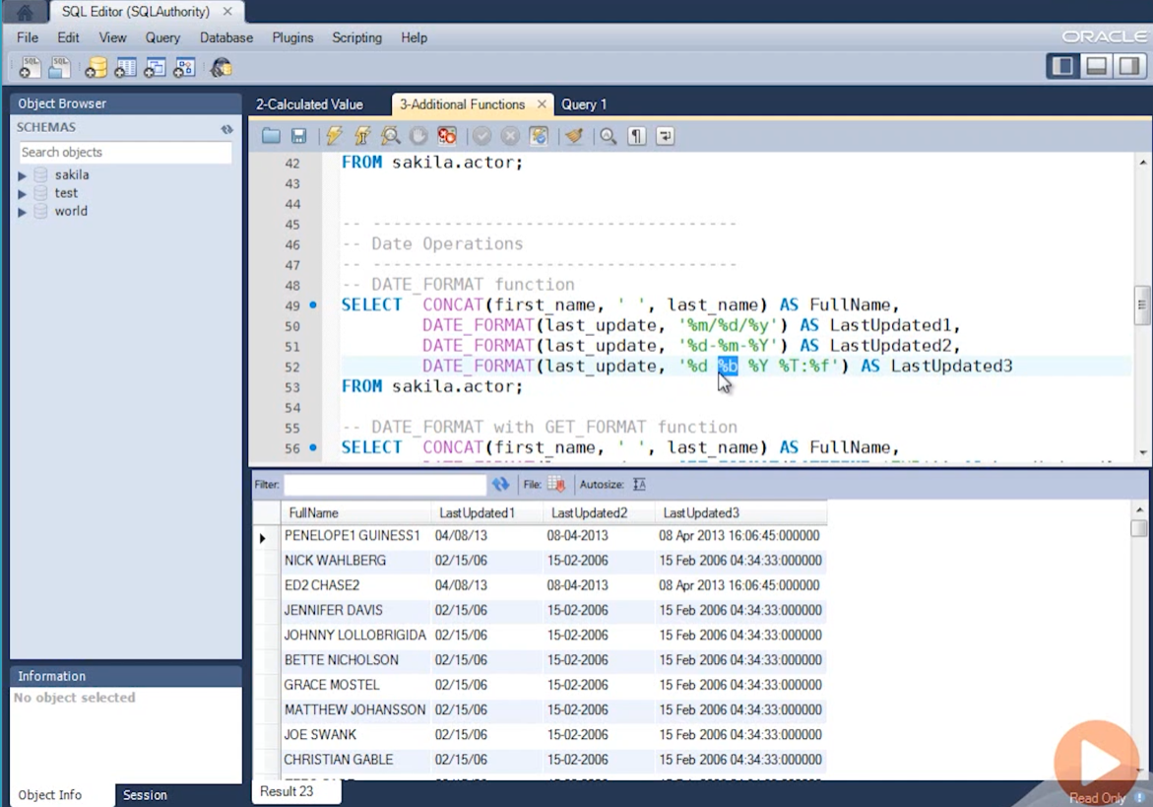
Date operation

Slide 28
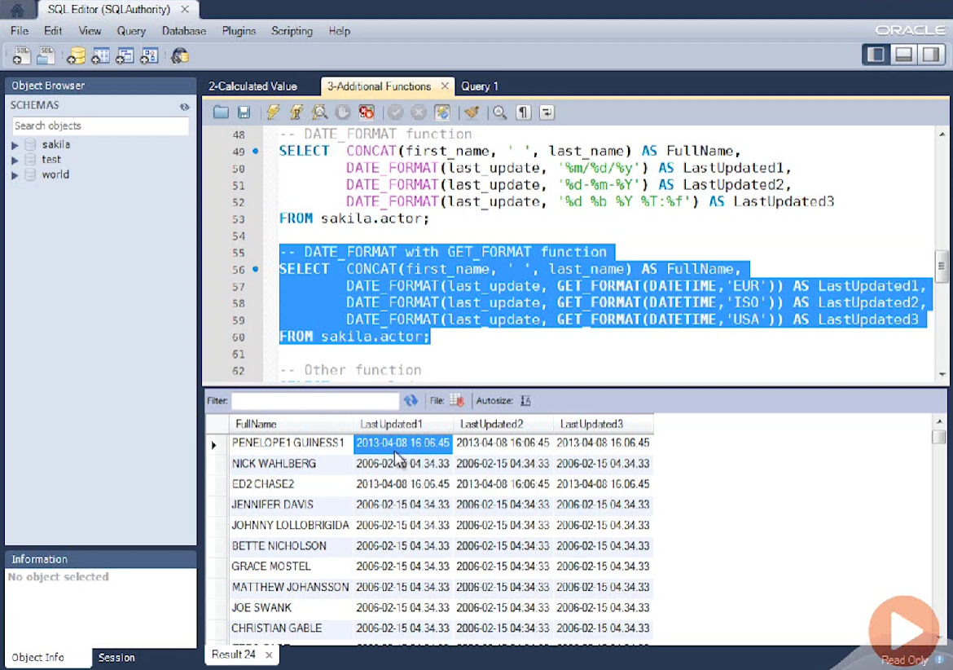

Slide 29
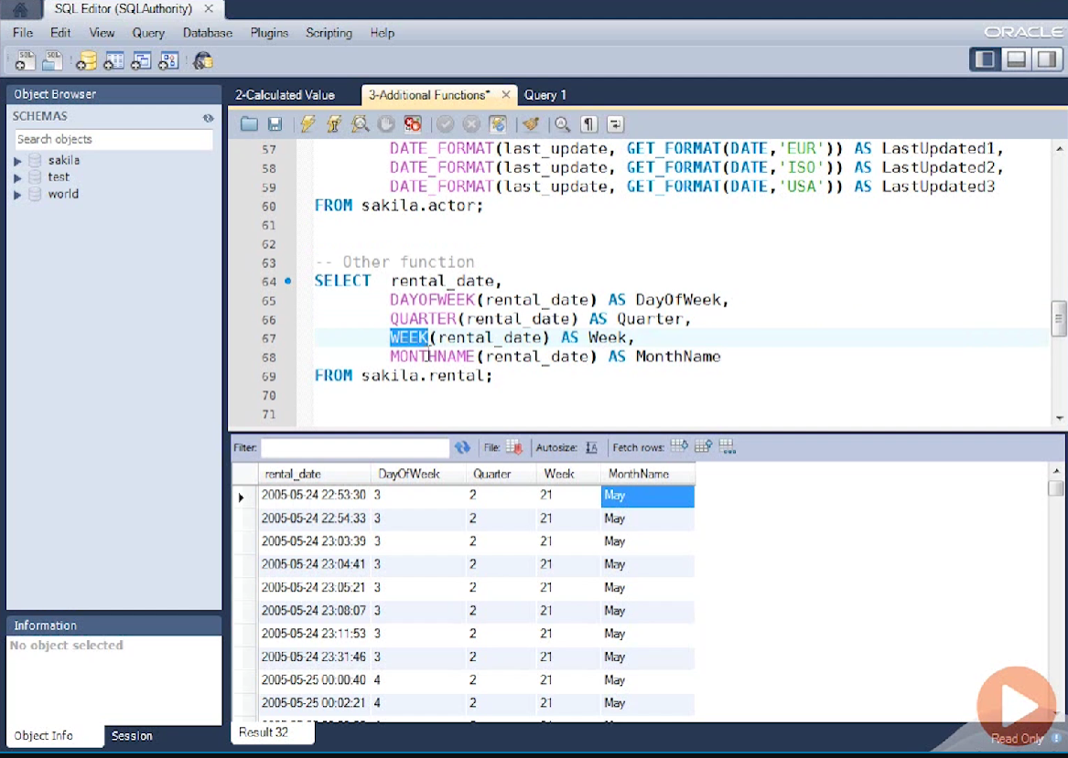

Slide 30
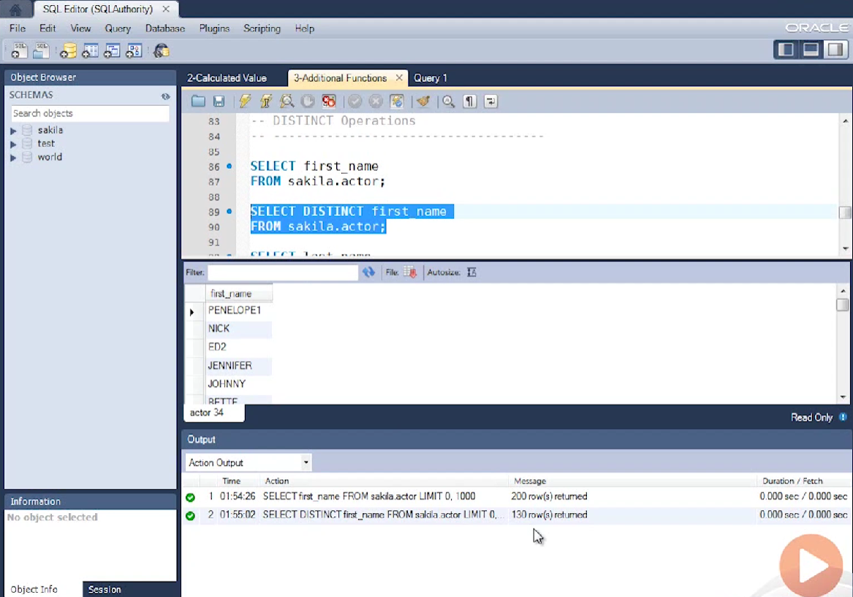
Distinct operation

Slide 31
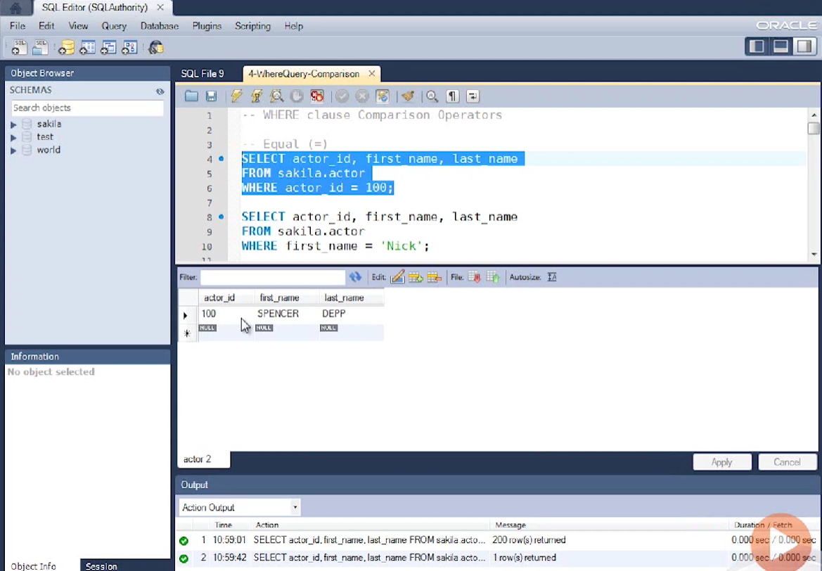
Where clause comparison operator

Slide 32
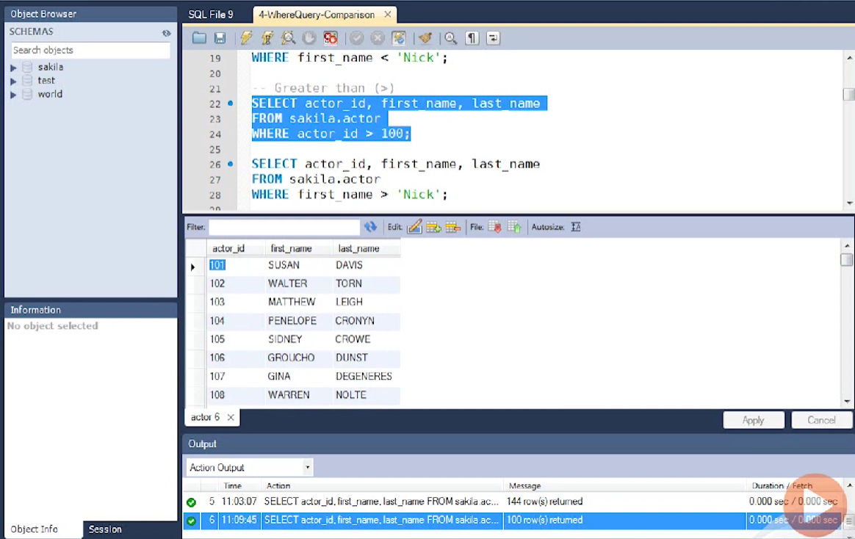

Slide 33
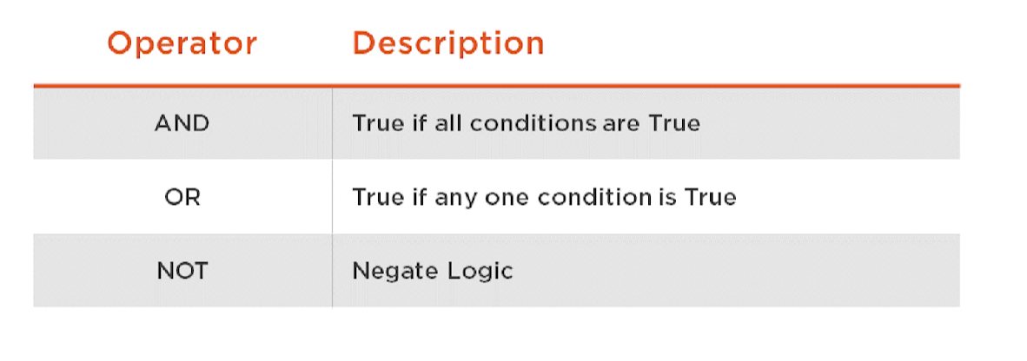
WHERE clause logical operator

Slide 34
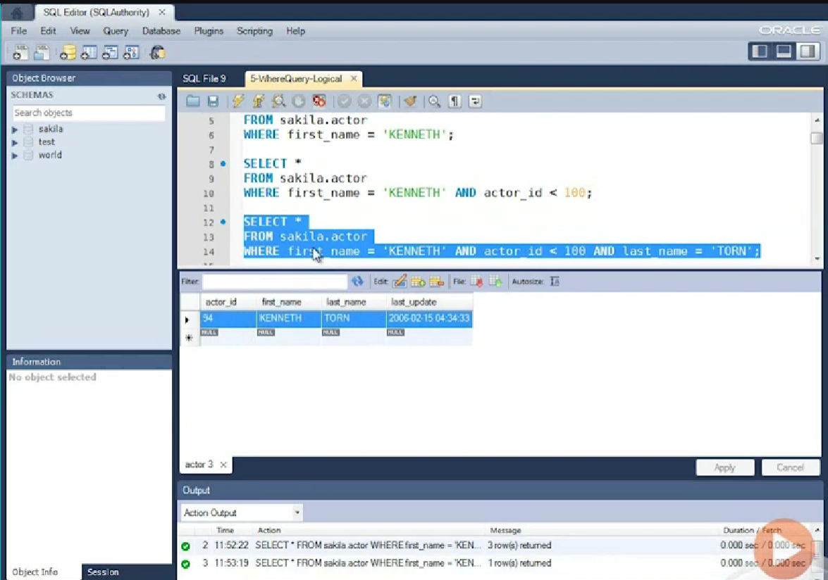

Slide 35
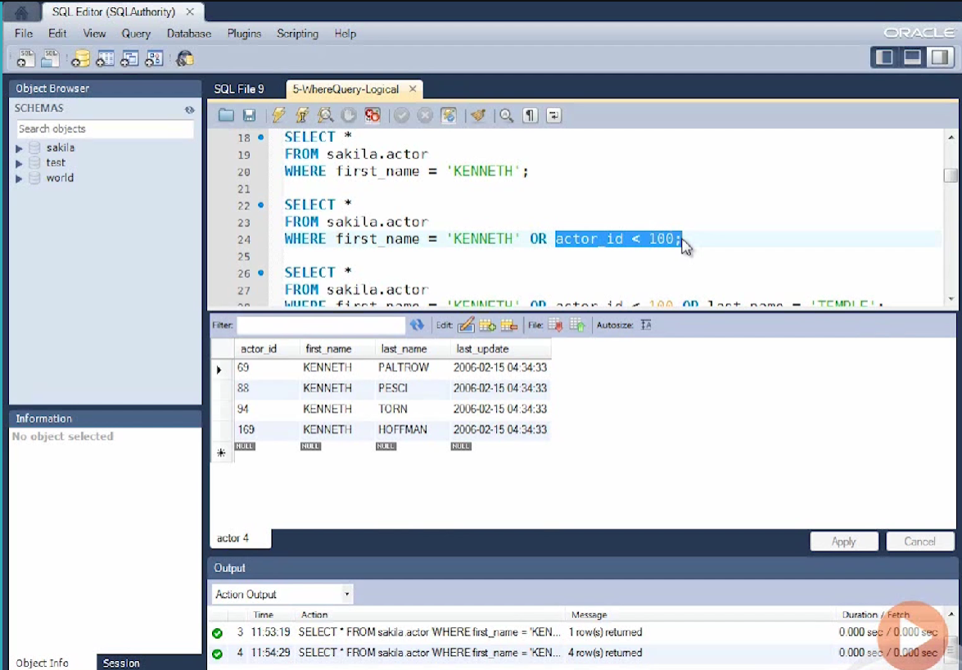

Slide 36
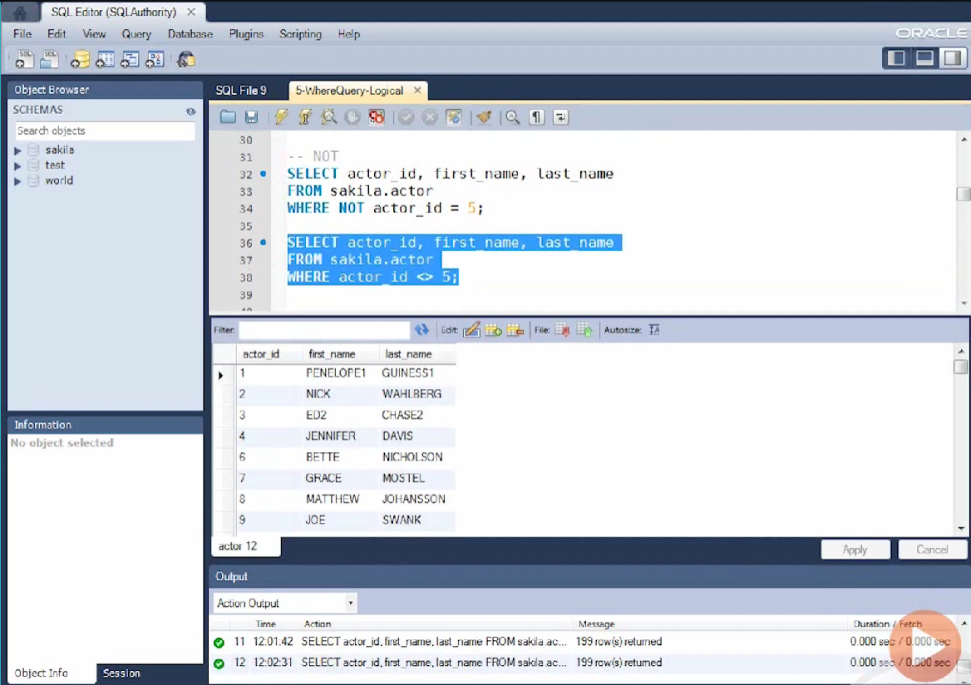

Slide 37
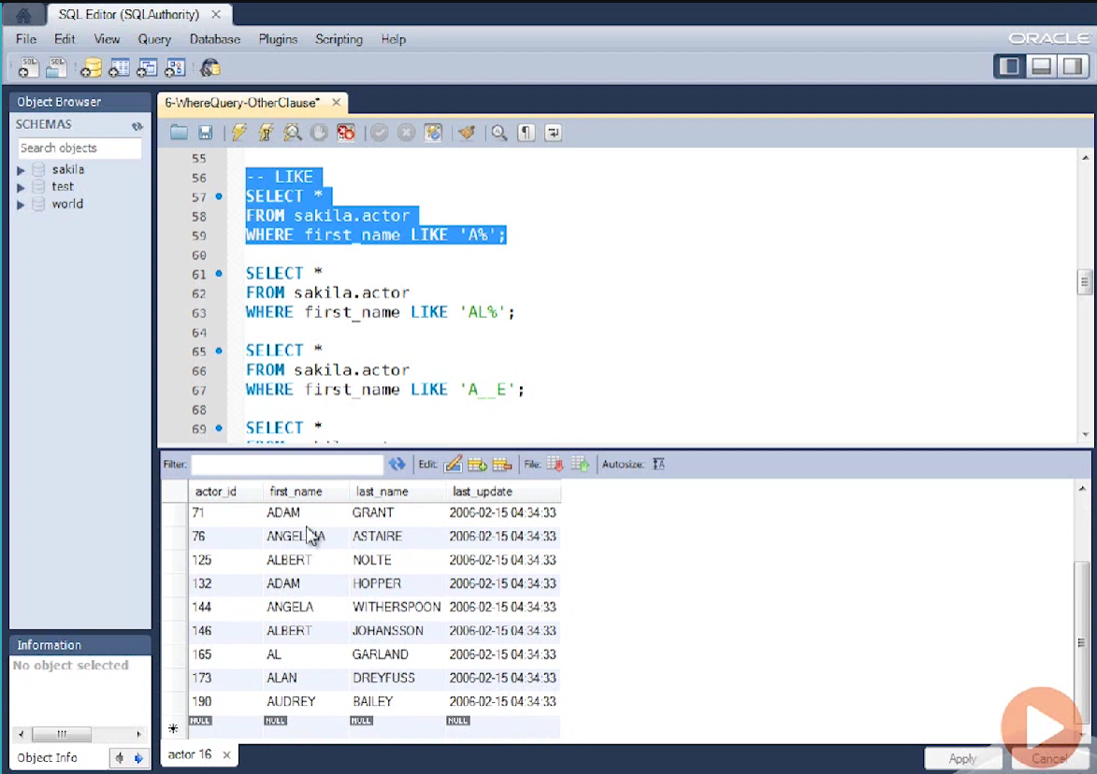
Like operator

Slide 38
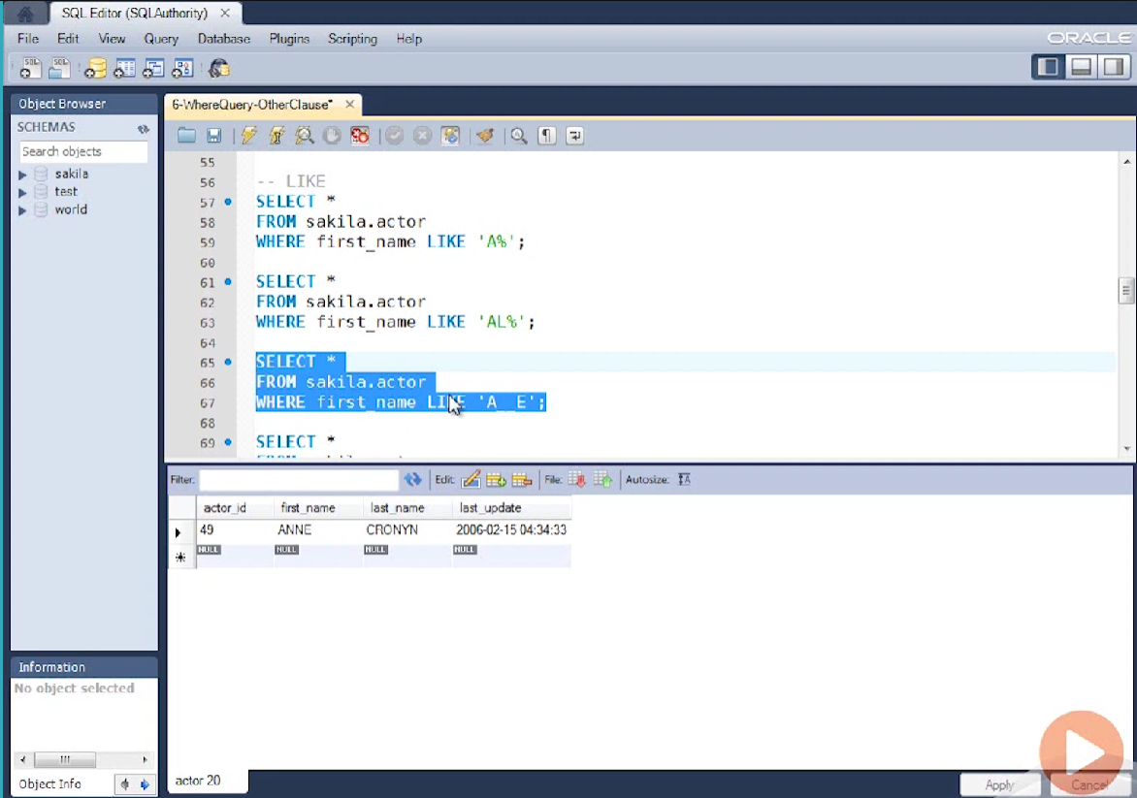

Slide 39
Order by clause
Sequence ascending descending
Single Column
Multi Column
Expression
Alias
Column Number

Slide 40
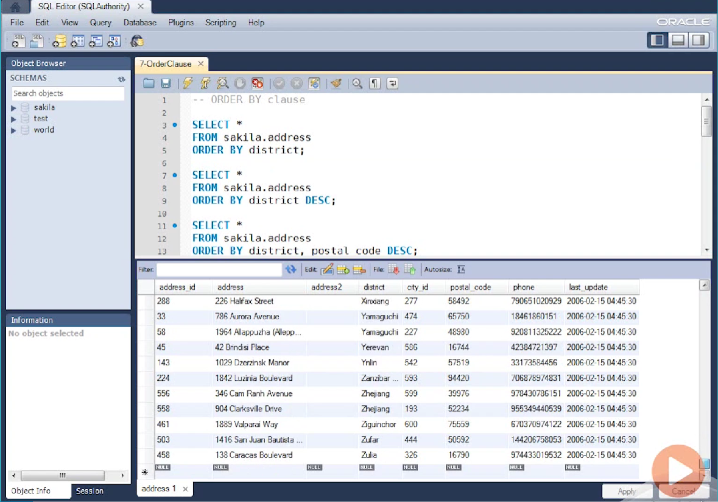

Slide 41
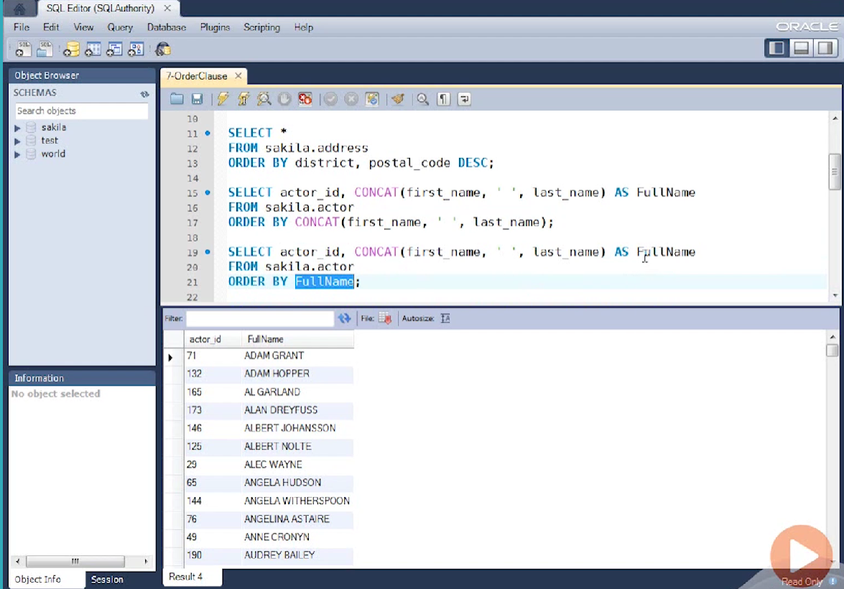

Slide 42
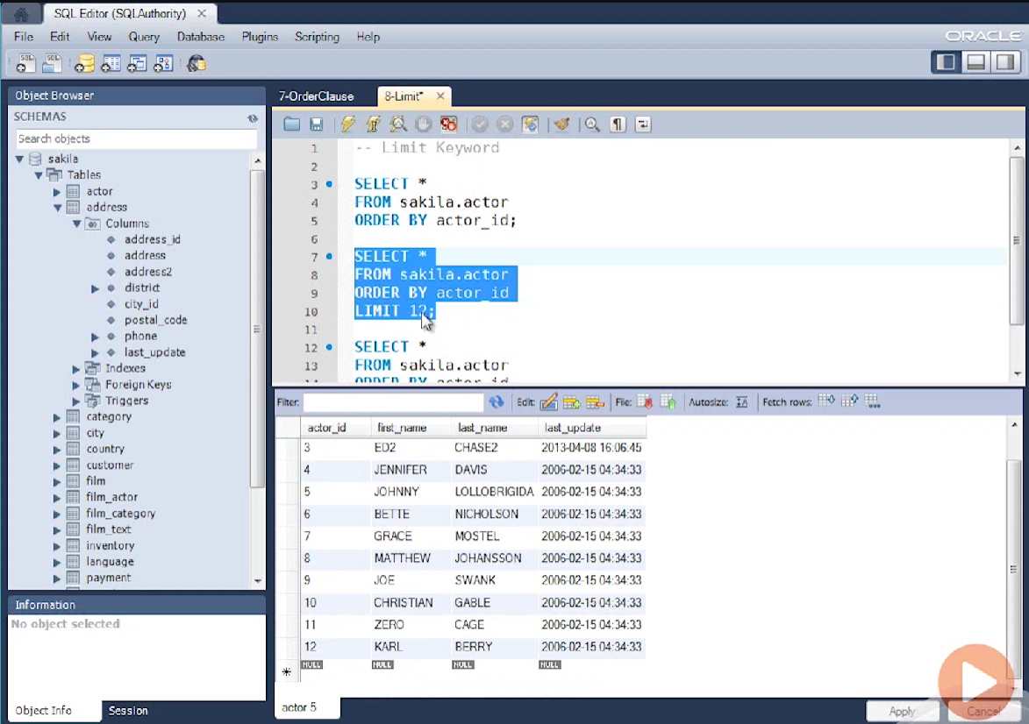
LIMIT operation

Slide 43
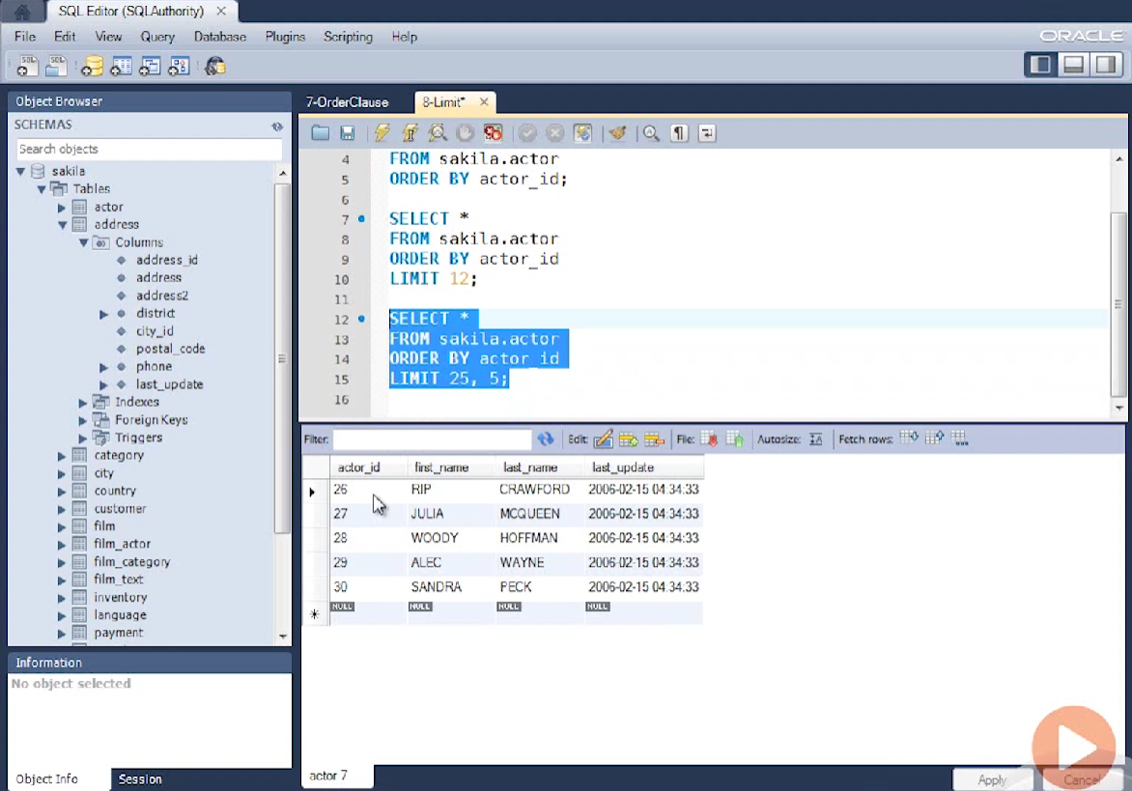

Slide 44
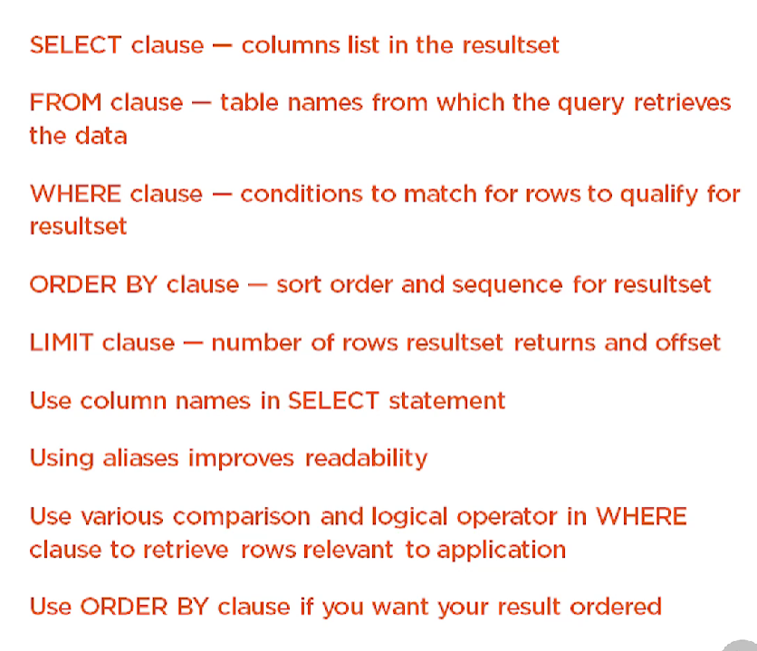

Slide 45
INSERT statement
UPDATE statement
DELETE statement

Slide 46
Insert statement
Single Row Insert using VALUES clause using SELECT statement
Multi row Insert using multiple VALUES clause using SELECT statement
Default values
Null values

Slide 47
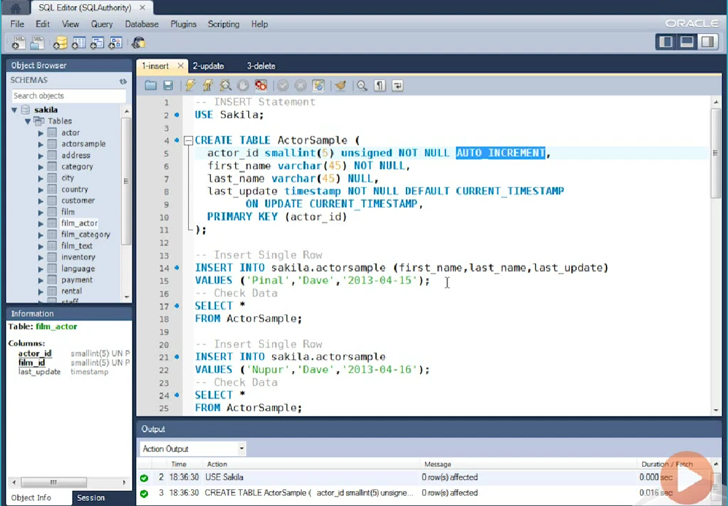

Slide 48
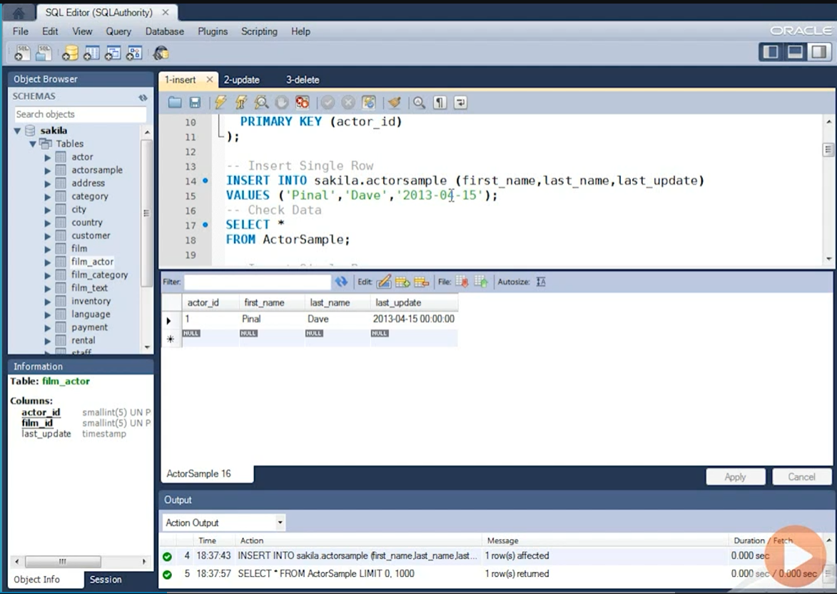

Slide 49
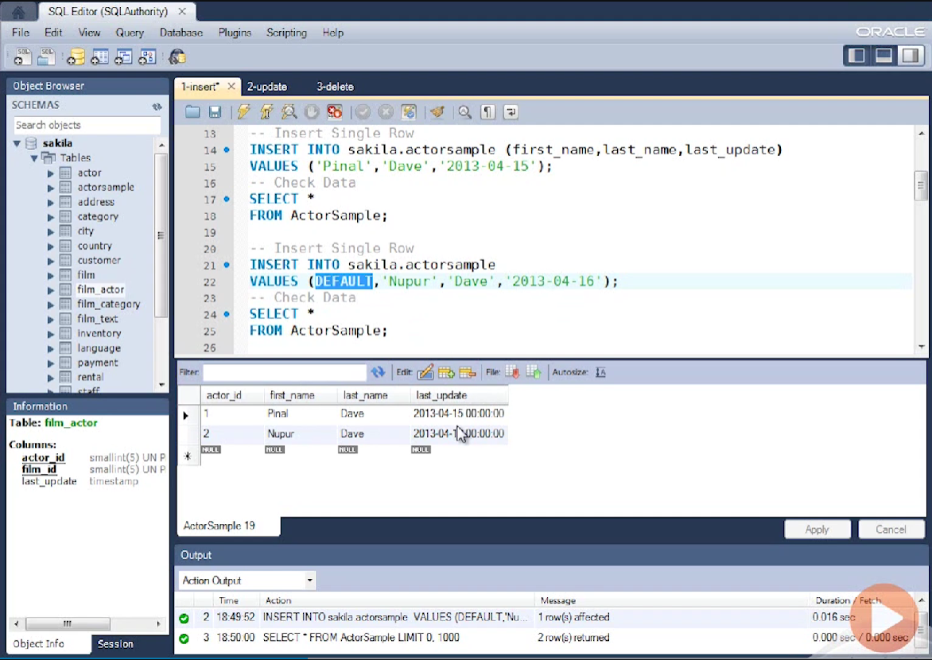

Slide 50
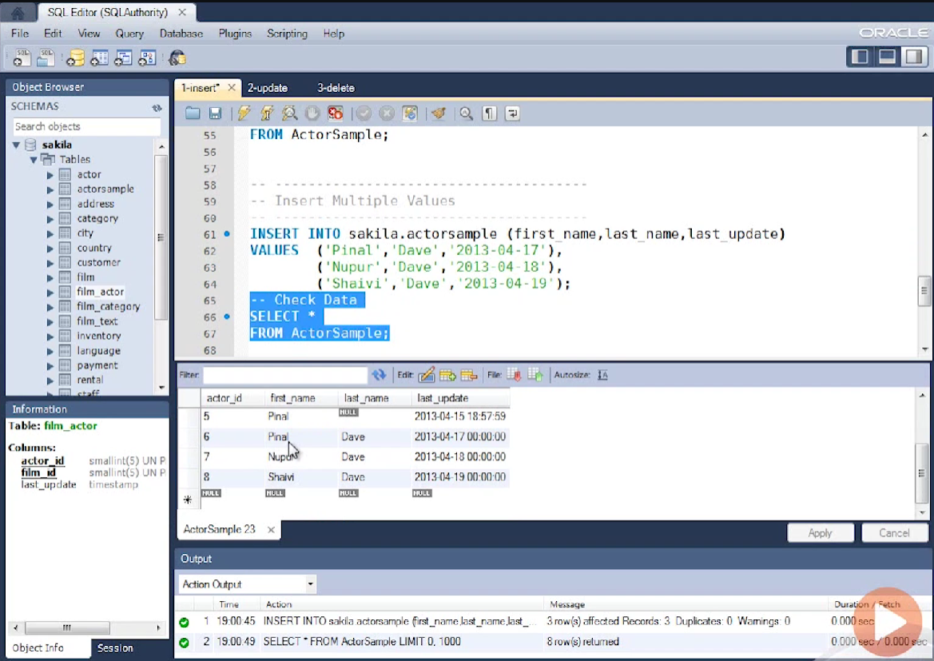

Slide 51
UPDATE statement
UPDATE using single row single column
UPDATE using single row multiple column
UPDATE using multiple row single column
UPDATE using multiple row multiple column
UPDATE using SELECT statement

Slide 52
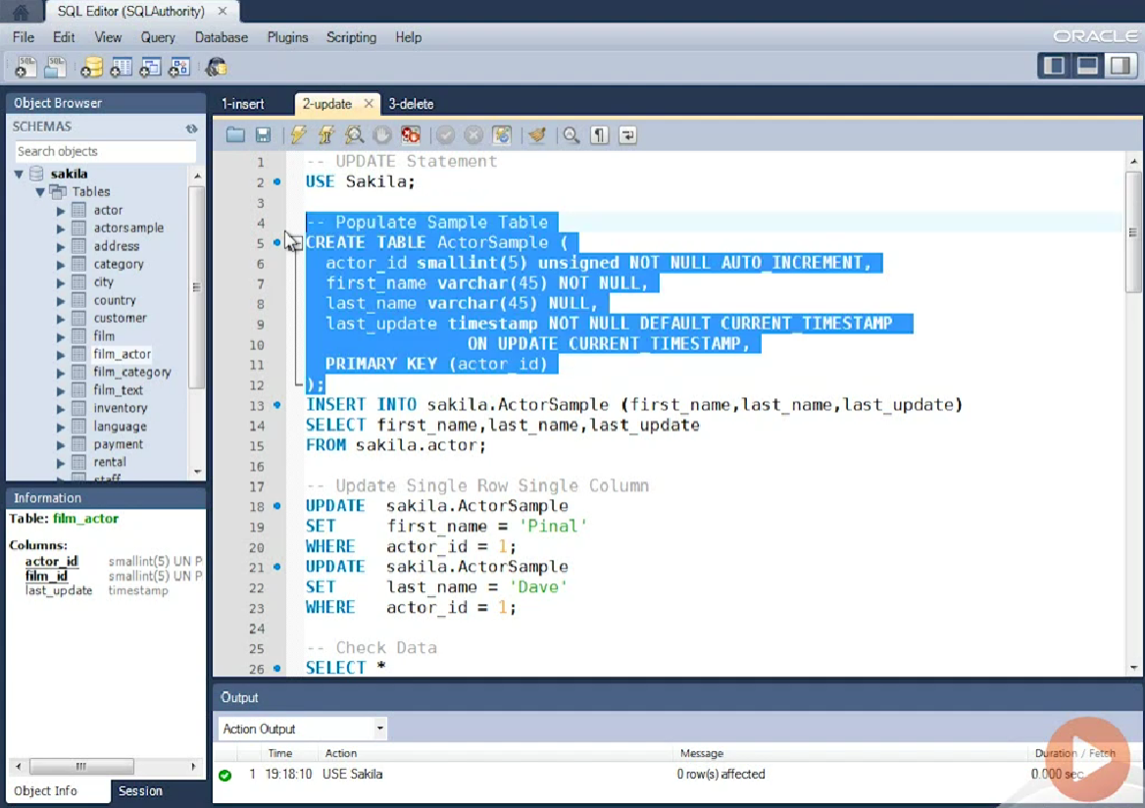

Slide 53
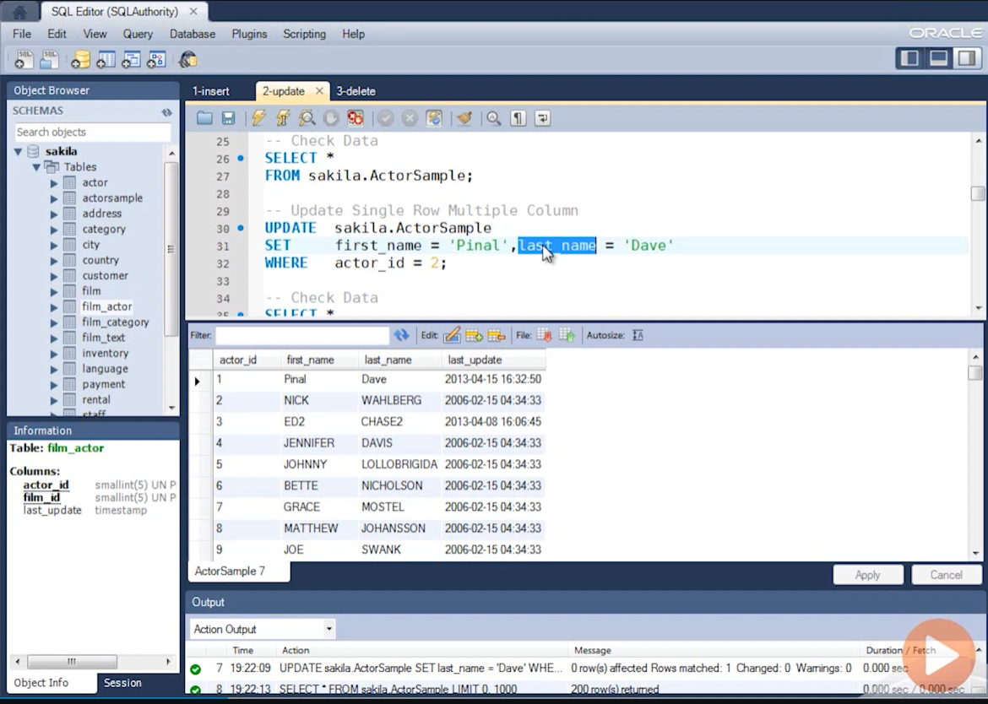

Slide 54
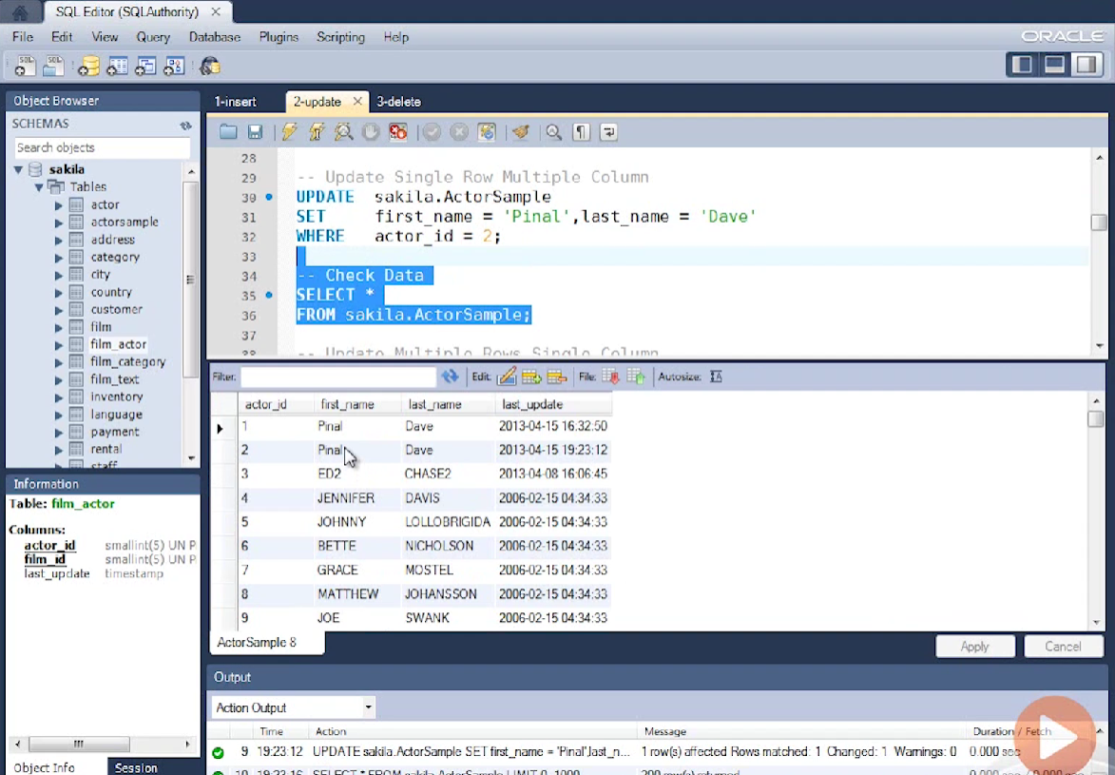

Slide 55
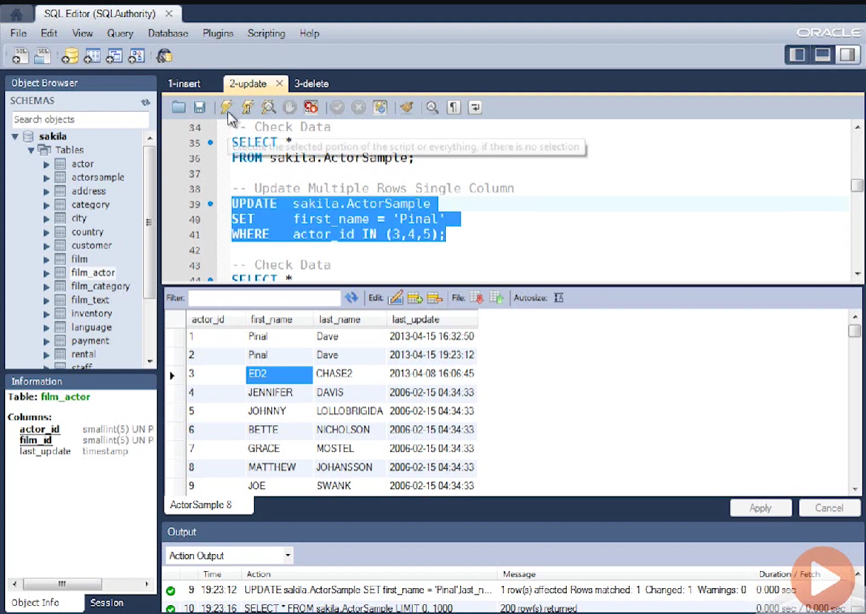

Slide 56
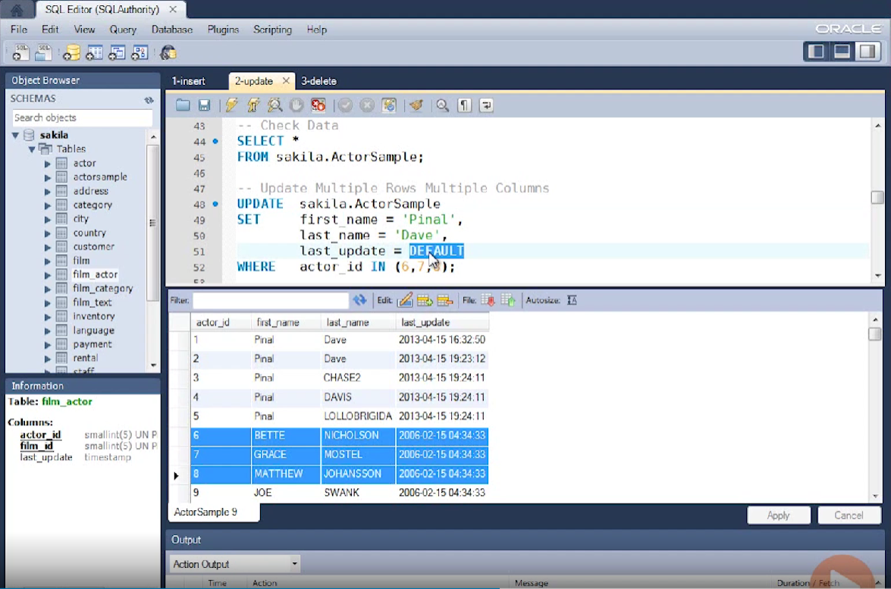

Slide 57
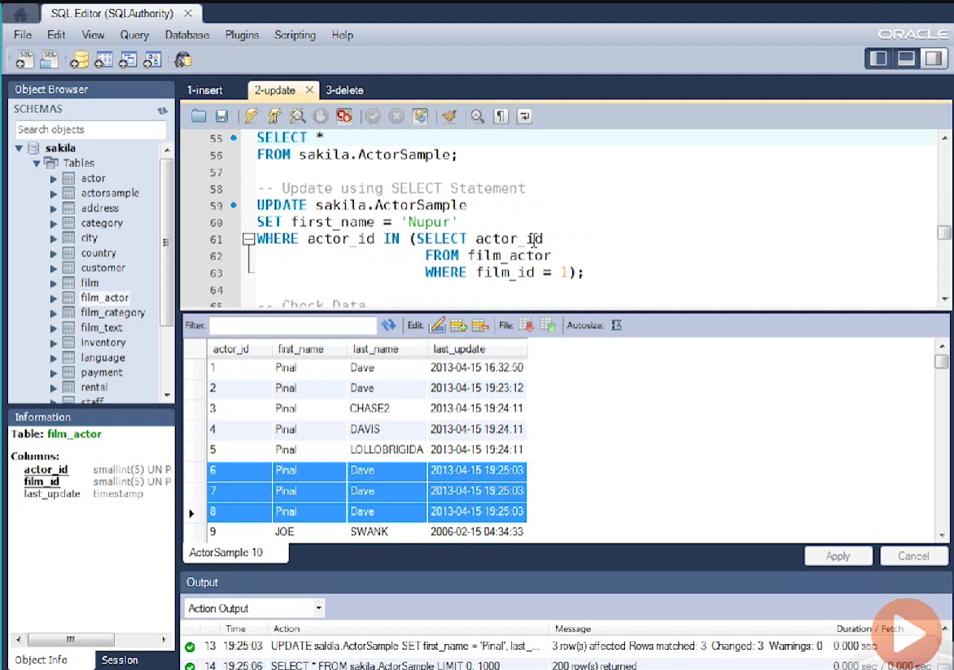

Slide 58
DELETE statement
DELETE single row
DELETE multiple rows
DELETE using SELECT statement
DELETE all rows from table

Slide 59
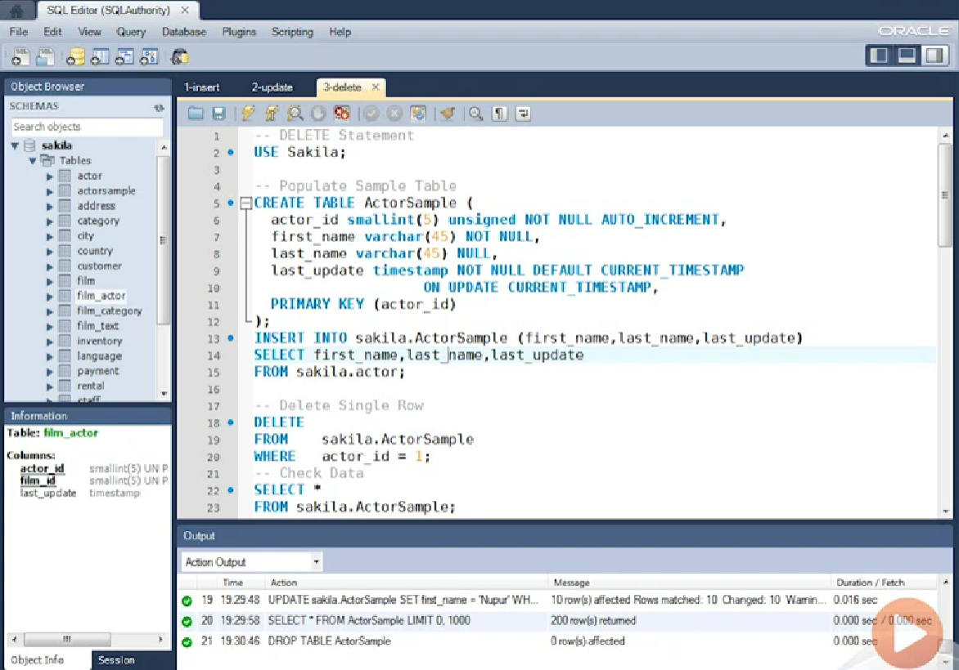

Slide 60


Slide 61


Slide 62


Slide 63


Slide 64


Slide 65
Use SELECT statement in subquery when inserting, updating or deleting
Multiple rows at a time.
Do not forget to specify WHERE clause in DELETE or UPDATE statement or it will modify your entire table.

